Slide 1
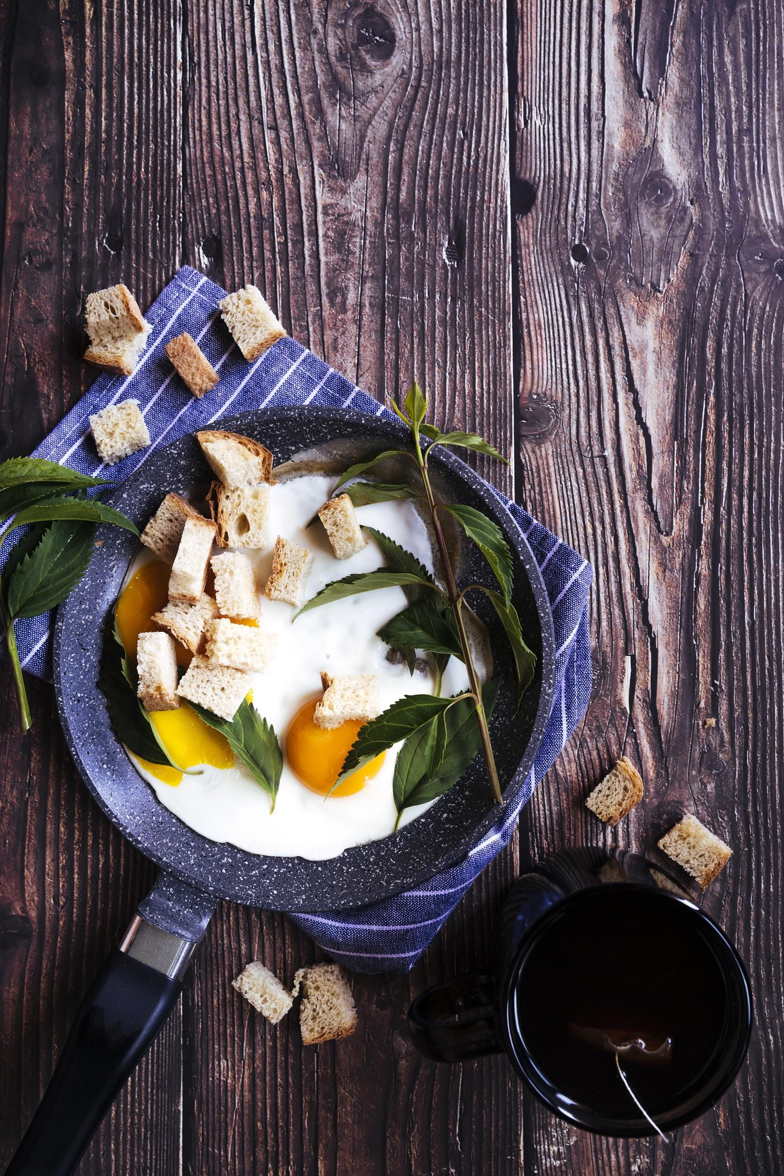
RECIPE RECOMMENDATION WEB APPLICATION
UNDER THE GUIDANCE OF PROF. SWAPNALI MAKADE
BY : AARTI BANDEKAR - 8296
ANJANA SINGH - 8304
MOUNITA BHAGAT - 8453

Slide 2
AGENDA
INTRODUCTION
01
04
IMPLEMENTATION
PROBLEM STATEMENT
02
05
RESULT
LITERATURE SURVEY
03
06
CONCLUSION

Slide 3
INTRODUCTION
It has become imperative that we put the things we already have in our kitchens to use and make healthy, sustainable meals out of them. Our web application aims to help solve this problem by providing a functionality that lets users enter the ingredients they have in a search bar and get recipe results based on them.
In addition to that, we have also trained and tested a machine learning model that classifies food images into five different categories, based on the customized Food101 dataset. We have used Convolution Neural Network. CNNs are used for image classification and recognition because of its high accuracy

Slide 4
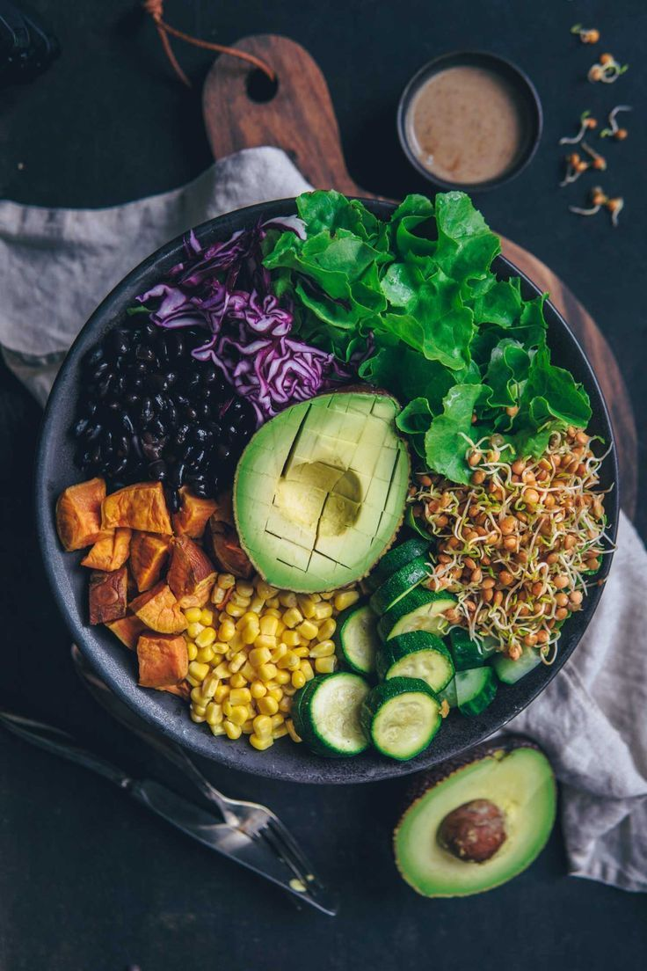
PROBLEM STATEMENT
The main objective of this proposed application is to suggest the user a preferred recipe using ingredient-based filtering algorithm.
In addition to that, we have also trained and tested a machine learning model that classifies food images into five different categories, based on the customized Food101 dataset. We have used Convolution Neural Network

Slide 5
LITERATURE SURVEY
JOURNAL PUBLICATIONS
REFERENCE
TITLE OF PAPERS
DESCRIPTION
Personalized web based application for movie recommendations
Killian Duay
Bachelor’s Thesis Degree program in Business Information Technology 2019
The aim of this thesis was first to study Machine Learning and the ways it can be used in the case of a movie recommender system. The main goal of the project was to develop a fully functional web application that allows users to get recommendations on all existing movies in the world.
https://www.theseus.fi/bitstream/handle/10024/172583/KillianDuay_thesis.pdf?sequence=2&isAllowed=y

Slide 6
LITERATURE SURVEY
JOURNAL PUBLICATIONS
REFERENCE
TITLE OF PAPERS
DESCRIPTION
Recipe Recommendation System using Machine Learning Models
1 Suyash Maheshwari and 2 Manas Chourey.
Student (B.E.), Information Technology, Sinhgad College Of Engineering, Pune, India. 2nd Student (B.E.), Information Technology, Sinhgad College Of Engineering, Pune, India
Here, they have used two machine learning models-vector space model and Word2Vec model to find top ingredient pairs from different cuisines and to suggest alternate ingredients.
https://www.irjet.net/archives/V6/i9/IRJET-V6I946.pdf

Slide 7
LITERATURE SURVEY
JOURNAL PUBLICATIONS
REFERENCE
TITLE OF PAPERS
DESCRIPTION
Discovery of Recipes Based on Ingredients using Machine Learning
S. Praveen 1, M.V. Prithvi Raj 2, R. Poovar San3, V. Thiruvengadam 4, M. Kevin Kumar 5
1,2,3,4B.Tech, Dept. Of Information Technology, Valliammai Engineering College, Chennai, Tamil Nadu 5Asst. Prof, Dept. Of Information Technology, Valliammai Engineering College, Chennai, Tamil Nadu
A Machine Learning approach was used in this project which enables to suggest the recipes based on the available ingredients by the user.
https://www.irjet.net/archives/V6/i3/IRJET-V6I328.pdf

Slide 8
LITERATURE SURVEY
JOURNAL PUBLICATIONS
REFERENCE
TITLE OF PAPERS
DESCRIPTION
Food detection and recipe recommendation
Jay Kukrejal,
A Machine Learning approach was used in this project which enables to suggest the recipes based on the available ingredients by the user.
https://www.irjet.net/archives/V6/i3/IRJET-V6I328.pdf

Slide 9
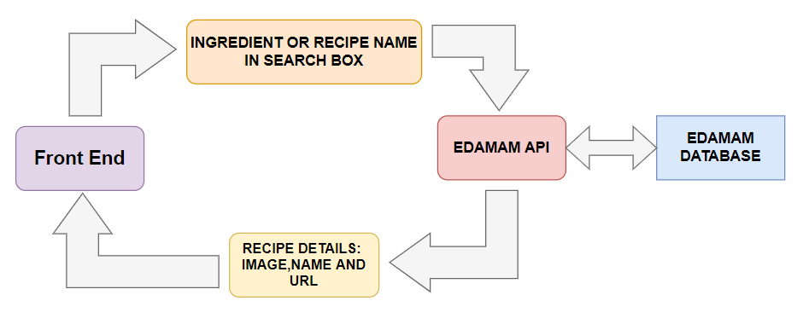
BLOCK DIAGRAM

Slide 10
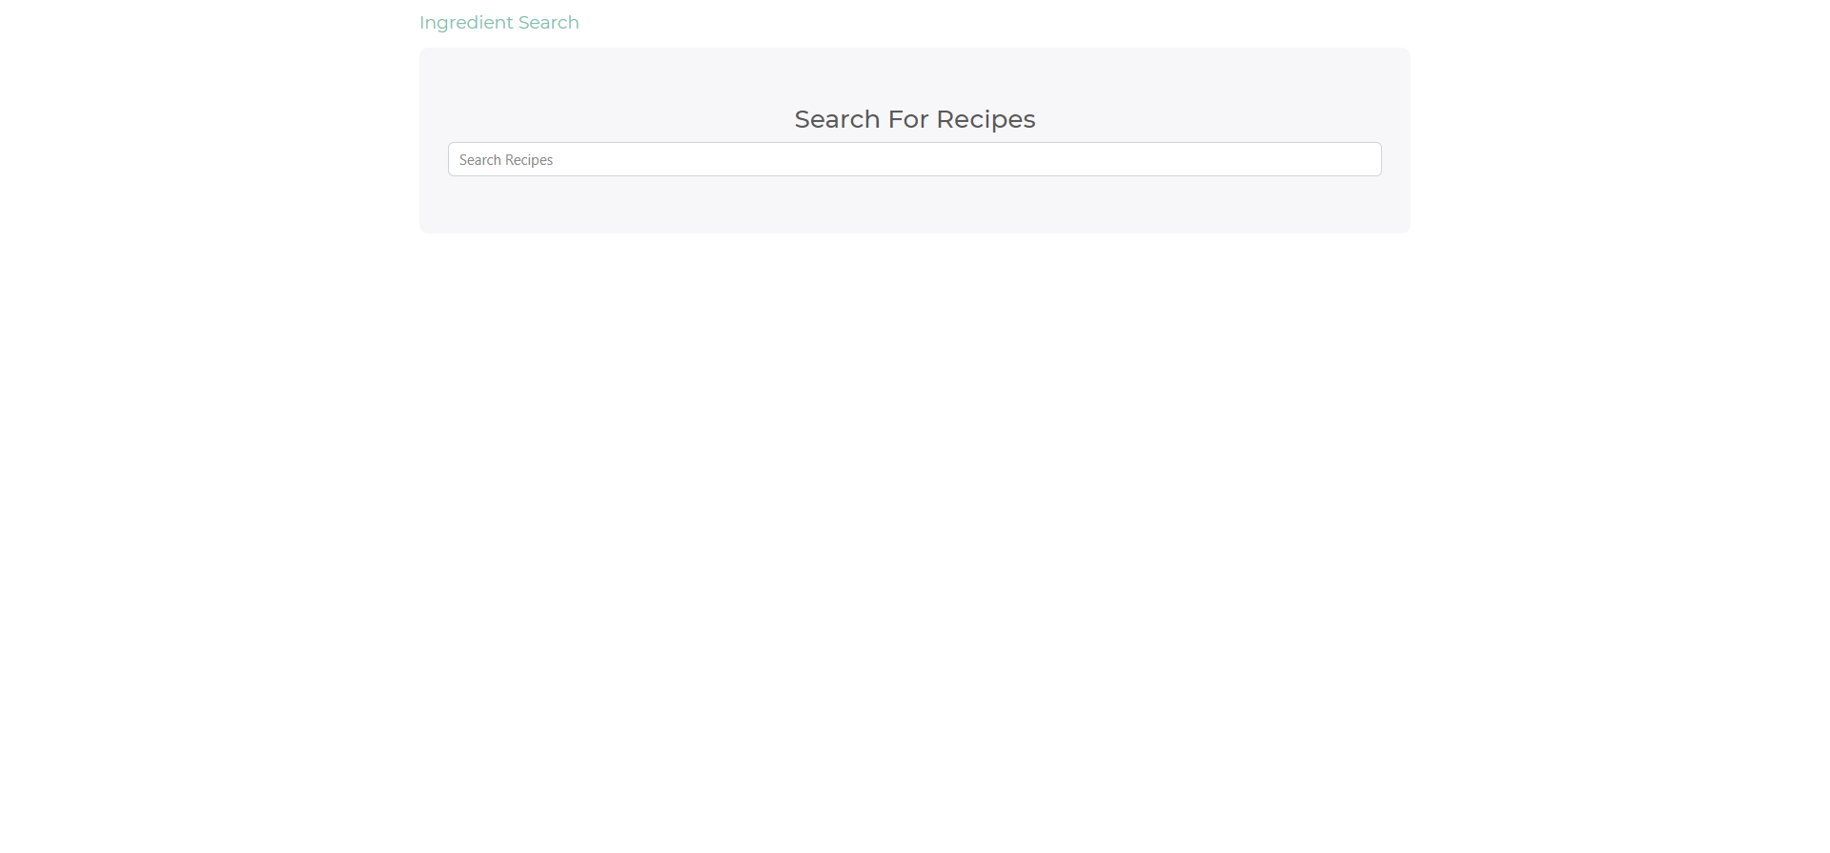
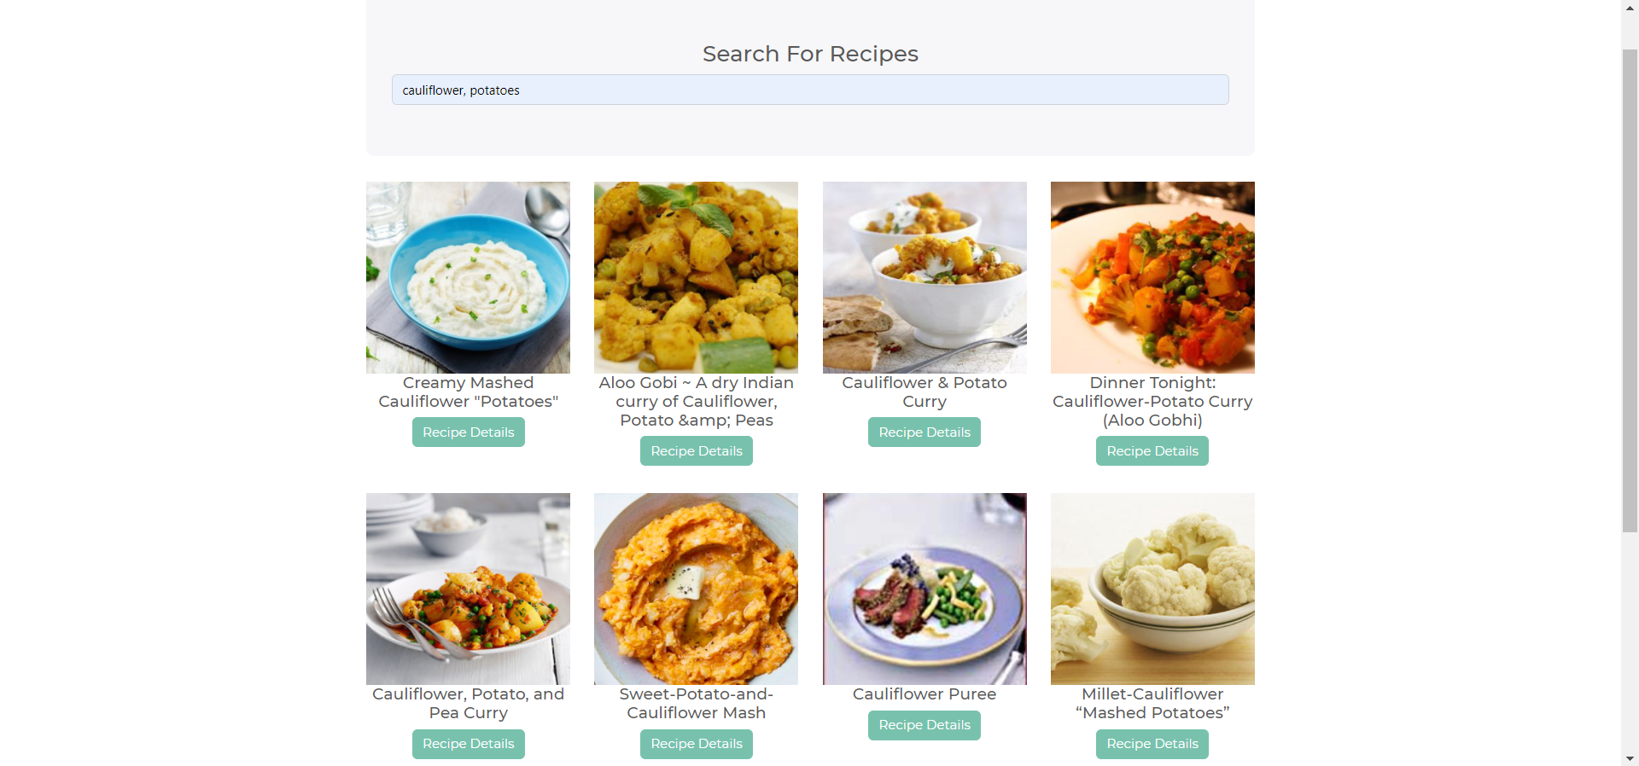
RECIPE RECOMMENDATION WEB APP

Slide 11
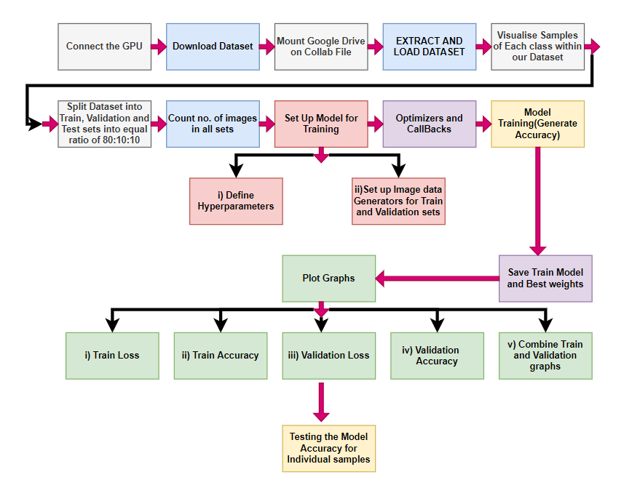
BLOCK DIAGRAM

Slide 12
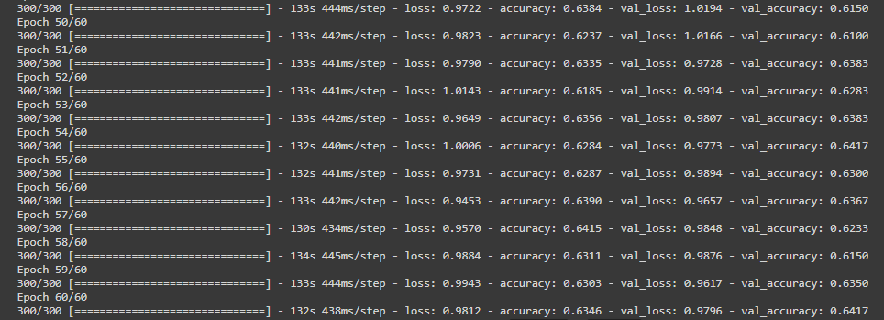
FOOD 101 DATASET- 12 CLASSES
Class Names:
Churros
Dumplings
French fries
Macarons
Pancakes
Red velvet cake
Sushi
Waffles
Chocolate cake
Grilled Salmon
Lasagna
Spring rolls

Slide 13
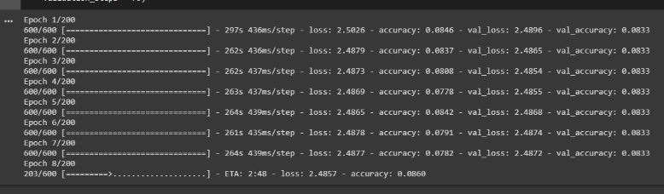
FOOD 11 DATASET- 11 CLASSES
Class Names:
Bread
Dairy Products
Dessert
Eggs
Fried food
Meat
Noodles pasta
Rice
Sea food
Soup
Vegetable Fruit

Slide 14
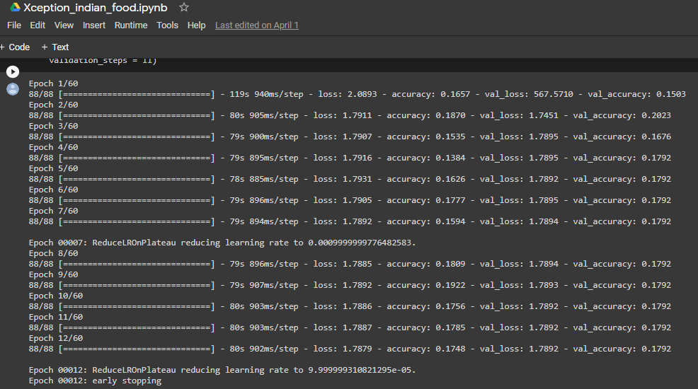
INDIAN FOOD DATASET- 20 CLASSES
Class Name:
Burger
Jalebi
Idli
Masala dosa
Pizza
Samosa
Butter naan
Chai
Chapati
Chole Bhature
Dal Makhani
Dhokla
Kulfi
Momos
Pani puri
Pakode
Pav Bhaji
Kadai Paneer
Kathi rolls

Slide 15
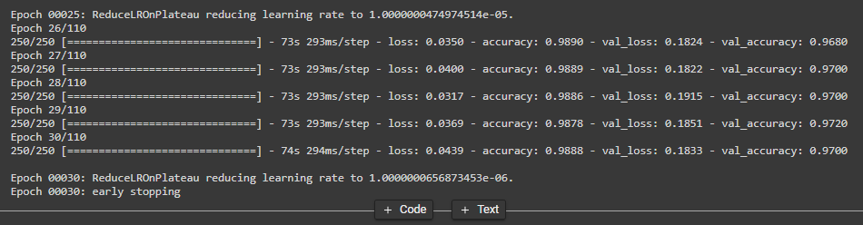
FOOD 101 DATASET with XCEPTION MODEL - 5 CLASSES
Class Names:
Dumplings
Lasagna
Macarons
Red velvet cake
Waffles

Slide 16
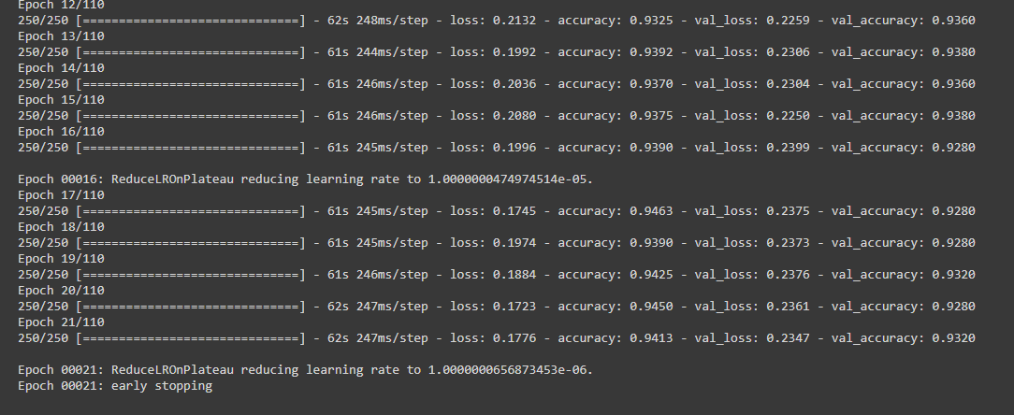
FOOD 101 DATASET WITH MOBILENET MODEL- 5 CLASSES
Class Names:
Dumplings
Lasagna
Macarons
Red Velvet Cake
Waffles

Slide 17
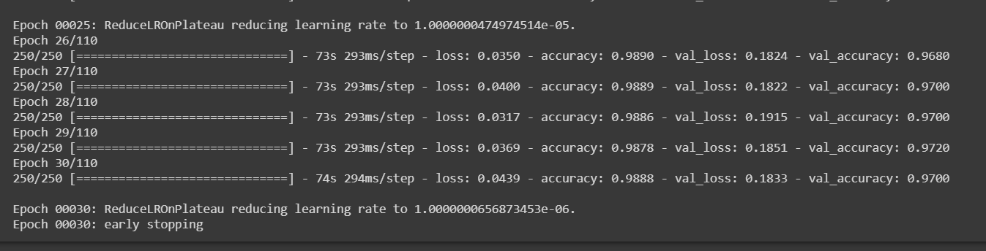
COMPARING THE TRAINING ACCURACY FOR XCEPTION AND MOBILENET MODELS
Xception model:

Slide 18
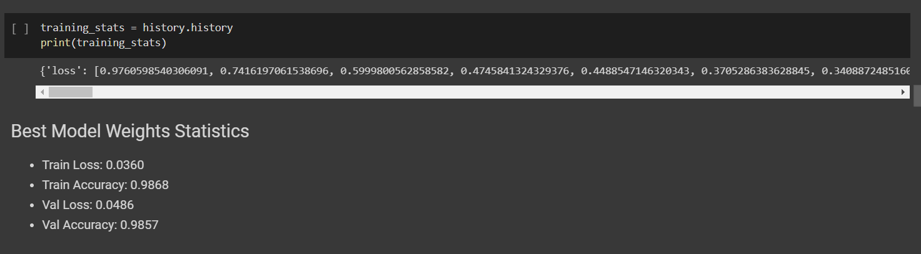

Slide 19
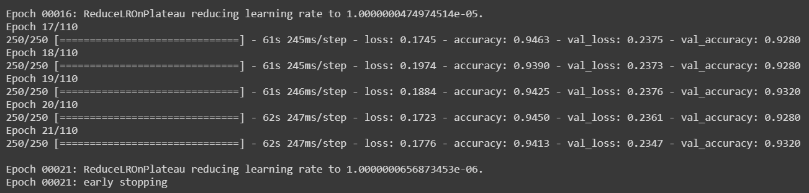
MobileNet Model:

Slide 20
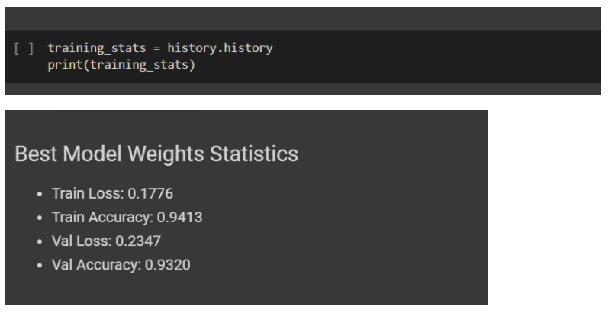

Slide 21
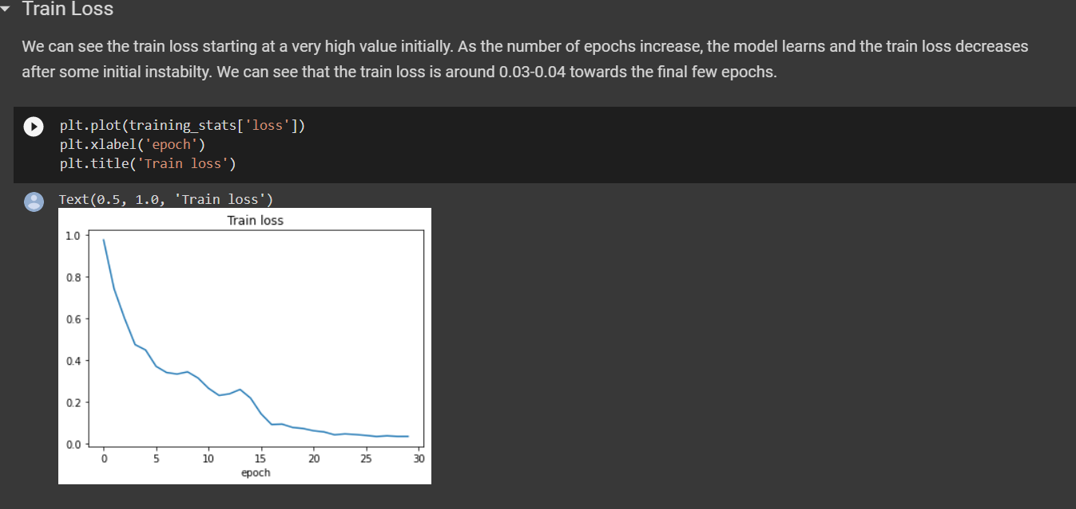
Xception

Slide 22
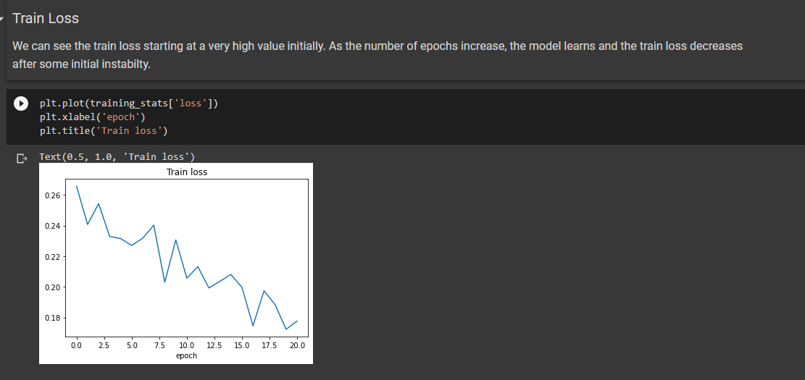
MobileNet

Slide 23
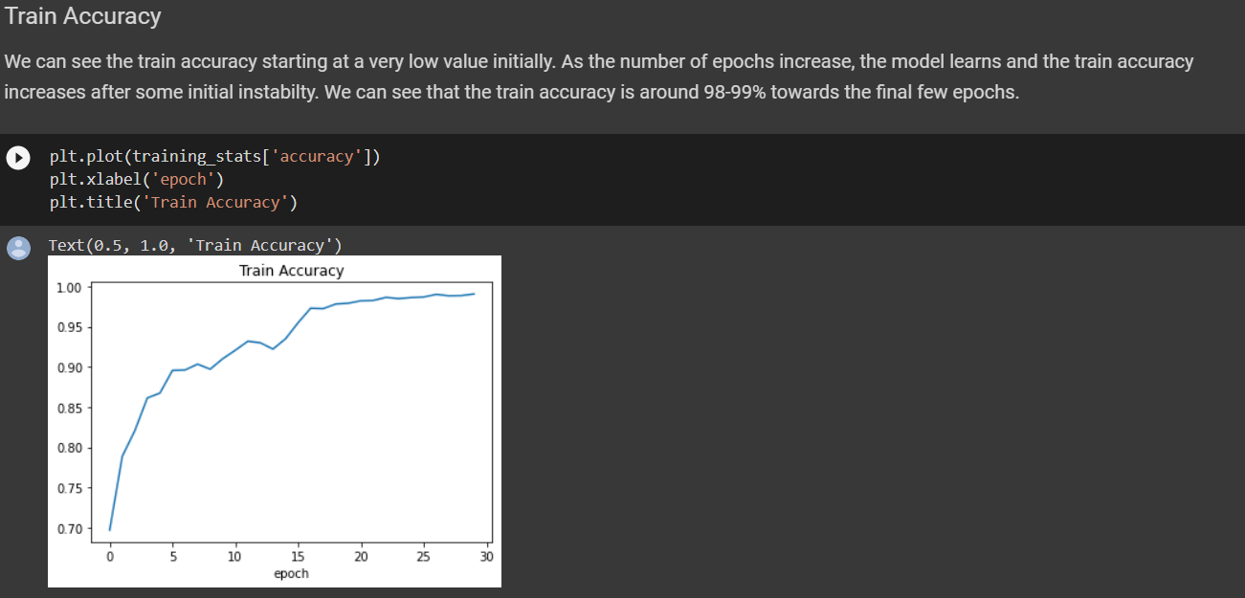
Xception

Slide 24
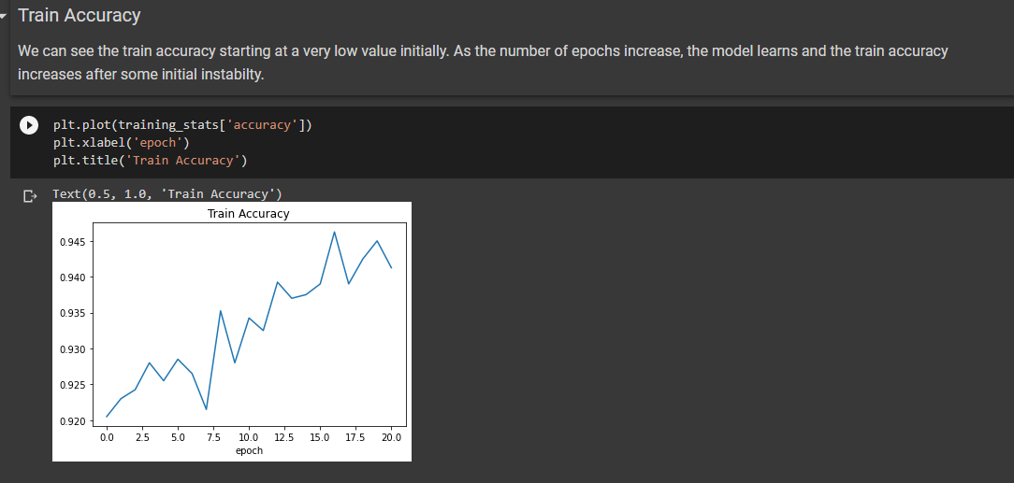
MobileNet

Slide 25
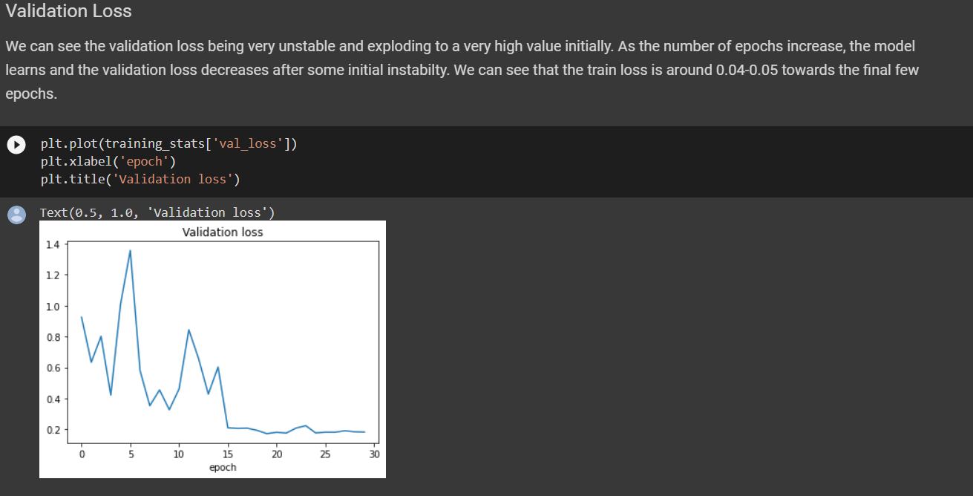
Xception

Slide 26
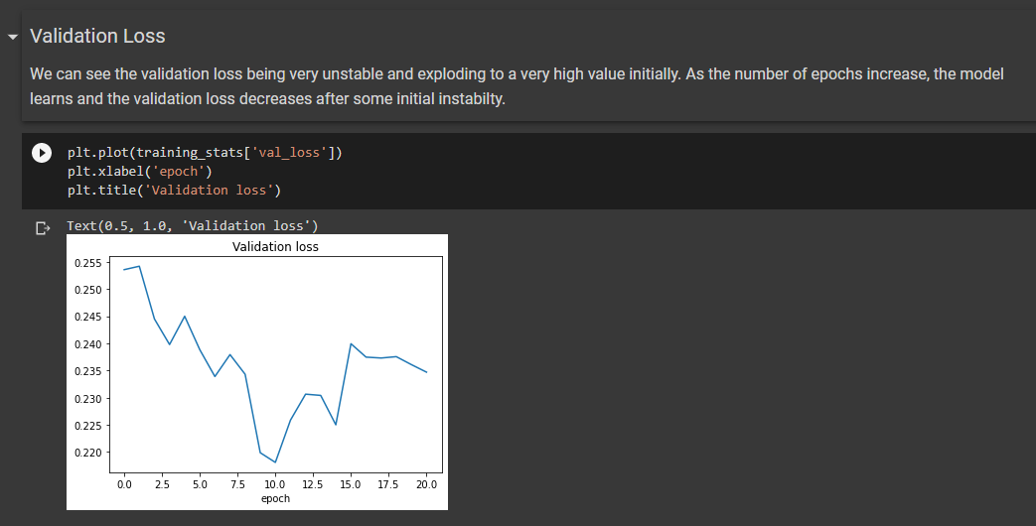
MobileNet

Slide 27
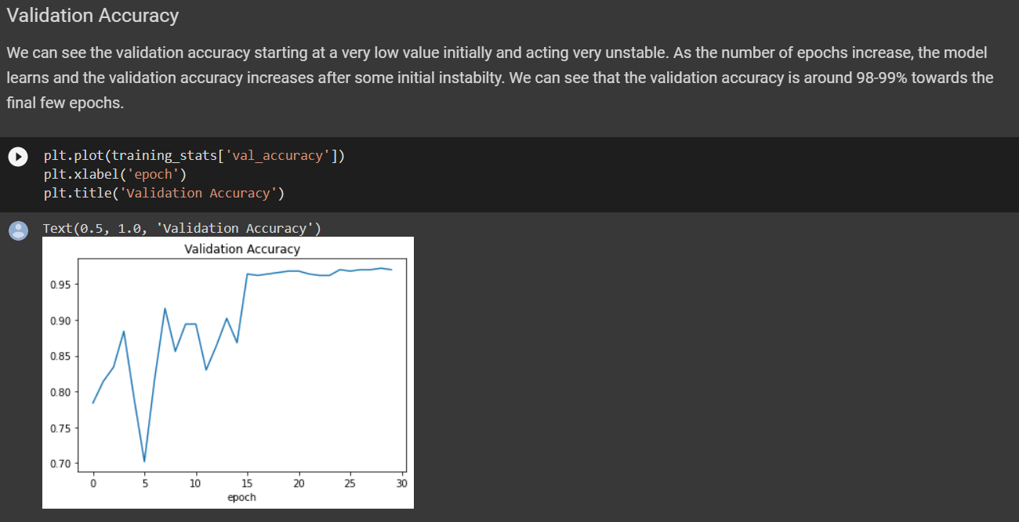
Xception

Slide 28
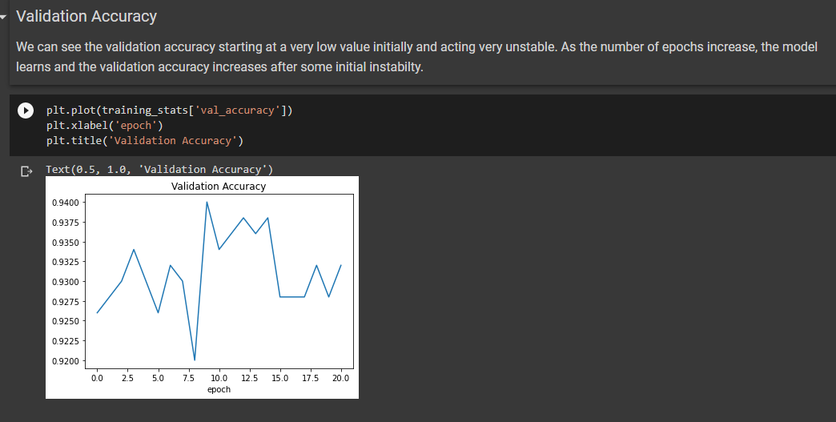
MobileNet

Slide 29
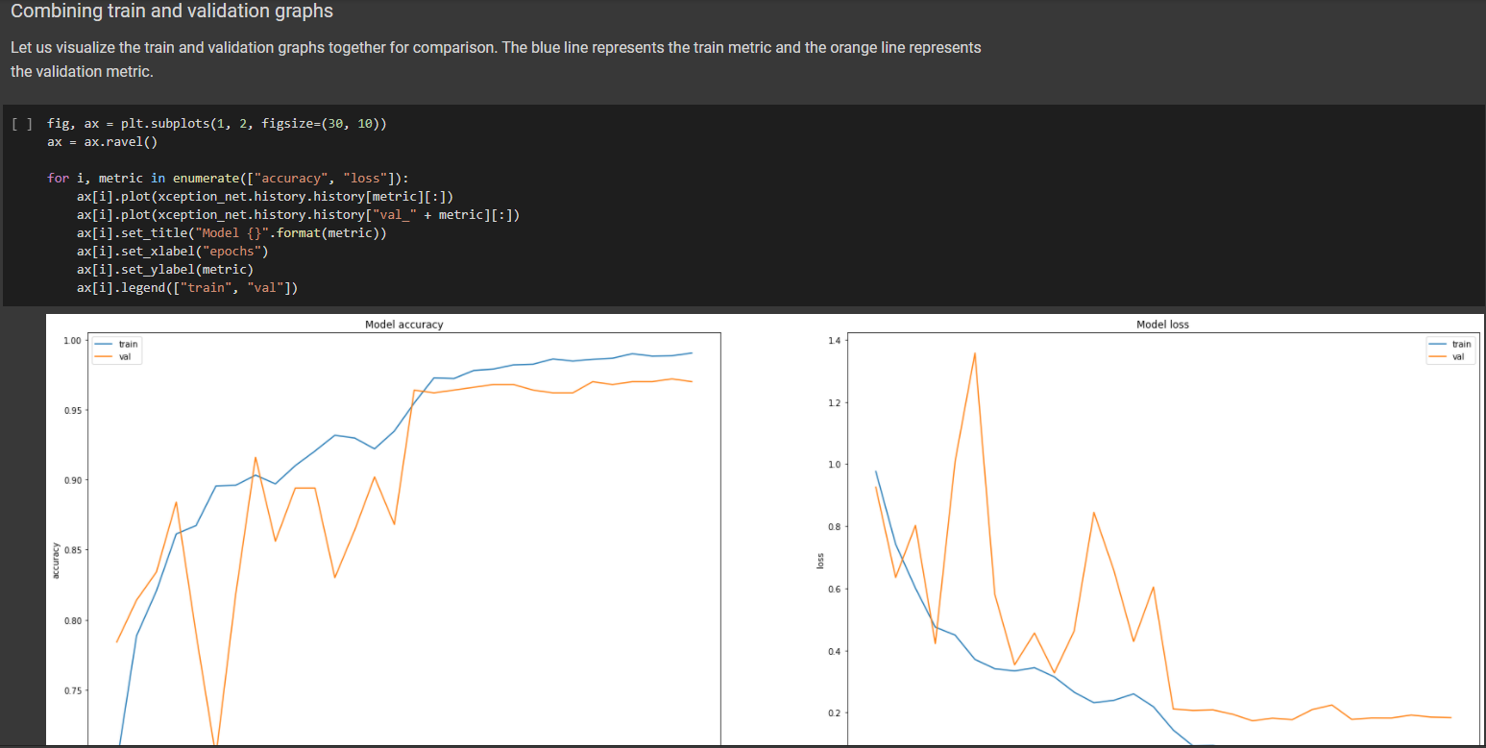
Xception

Slide 30
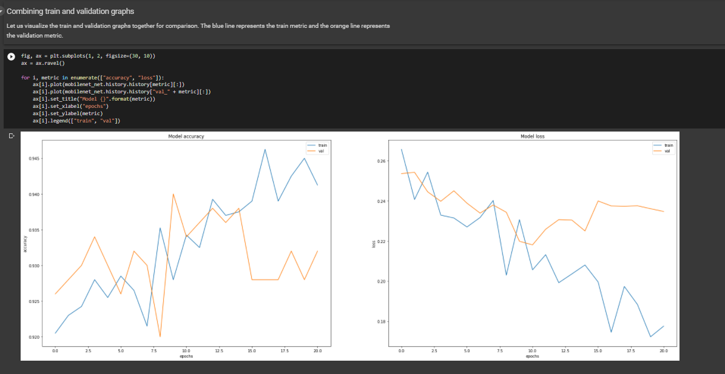
MobileNet

Slide 31
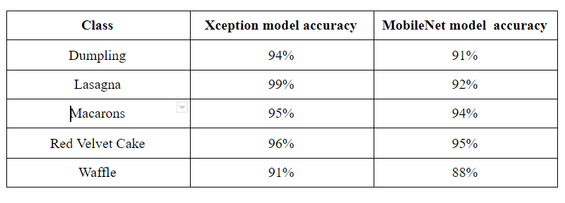
Comparing the Testing Accuracy for Xception and MobileNet models

Slide 32
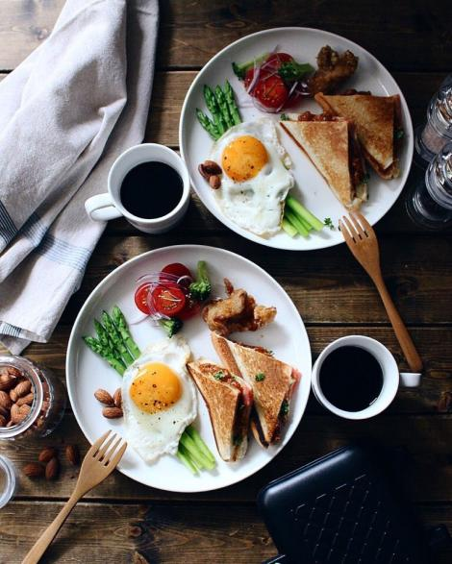
CONCLUSION:
The idea behind this project is to encourage users to adopt a healthy alternative to the conventional dining out system, which is especially observed among working-class adults and students, that arise because it is easier for people to order out than to decide on what to cook, however, such practices, in the long run, can not only lead to severe health complications but are also not budget-friendly. Since food photos are huge on social media and are easy-to-produce and relevant to everyone, we built a deep learning model to identify a food image and provide the recipe for people to cook.

Slide 33
REFERENCES
https://www.irjet.net/archives/V6/i9/IRJET-V6I946.pdf
https://www.irjet.net/archives/V6/i3/IRJET-V6I328.pdf
https://www.theseus.fi/bitstream/handle/10024/172583/KillianDuay_
thesis.pdf?sequence=2&isAllowed=y
https://school.geekwall.in/p/rJaqp8EqN/machine-learning-web-application
-using-react-and-flask

Slide 34
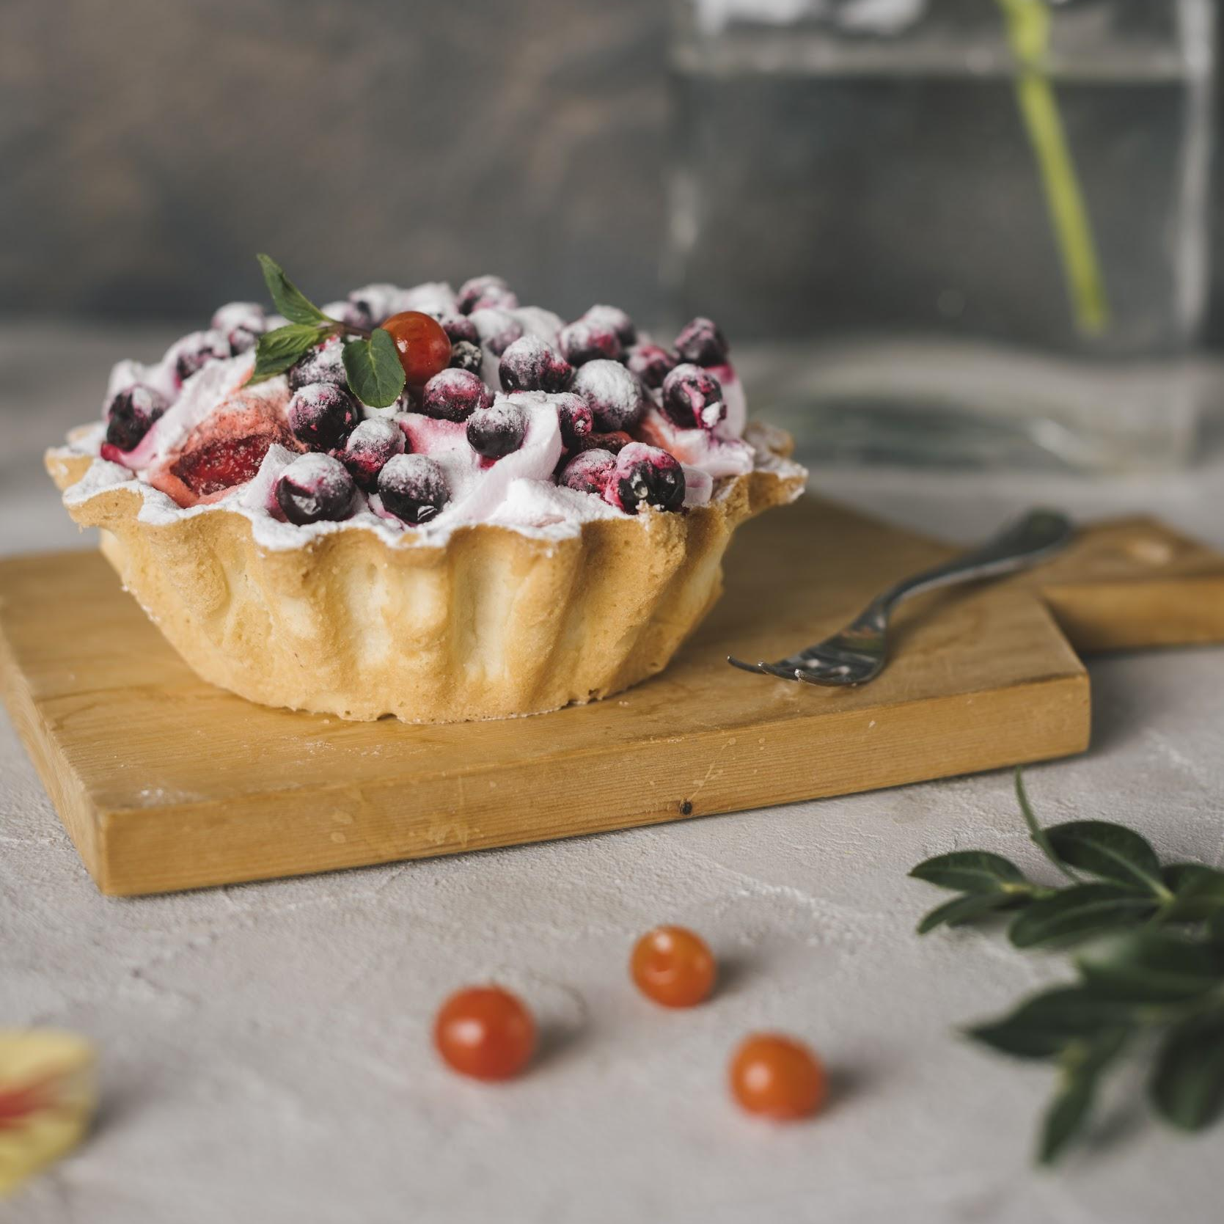
THANKS

